Slide 1

William Stallings Computer Organization and Architecture 10th Edition
Notes:
Lecture slides prepared for “Computer Organization and Architecture”, 10/e, by William Stallings, Chapter 2 “Performance Issues”.

Slide 2
Chapter 2
Performance Issues
Notes:
This chapter addresses the issue of computer system performance. We begin with a
consideration of the need for balanced utilization of computer resources, which provides
a perspective that is useful throughout the book. Next we look at contemporary
computer organization designs intended to provide performance to meet current
and projected demand. Finally, we look at tools and models that have been developed
to provide a means of assessing comparative computer system performance.

Slide 3
Designing for Performance
The cost of computer systems continues to drop dramatically, while the performance and capacity of those systems continue to rise equally dramatically
Today’s laptops have the computing power of an IBM mainframe from 10 or 15 years ago
Processors are so inexpensive that we now have microprocessors we throw away
Desktop applications that require the great power of today’s microprocessor-based systems include:
Image processing
Three-dimensional rendering
Speech recognition
Videoconferencing
Multimedia authoring
Voice and video annotation of files
Simulation modeling
Businesses are relying on increasingly powerful servers to handle transaction and database processing and to support massive client/server networks that have replaced the huge mainframe computer centers of yesteryear
Cloud service providers use massive high-performance banks of servers to satisfy high-volume, high-transaction-rate applications for a broad spectrum of clients
Notes:
Year by year, the cost of computer systems continues to drop dramatically, while the
performance and capacity of those systems continue to rise equally dramatically.
Today’s laptops have the computing power of an IBM mainframe from 10 or 15
years ago. Thus, we have virtually “free” computer power. Processors are so inexpensive
that we now have microprocessors we throw away. The digital pregnancy test is
an example (used once and then thrown away). And this continuing technological
revolution has enabled the development of applications of astounding complexity
and power. For example, desktop applications that require the great power of
today’s microprocessor-based systems include
■ Image processing
■ Three-dimensional rendering
■ Speech recognition
■ Videoconferencing
■ Multimedia authoring
■ Voice and video annotation of files
■ Simulation modeling
Workstation systems now support highly sophisticated engineering and scientific
applications and have the capacity to support image and video applications. In addition,
businesses are relying on increasingly powerful servers to handle transaction
and database processing and to support massive client/server networks that have
replaced the huge mainframe computer centers of yesteryear. As well, cloud service
providers use massive high-performance banks of servers to satisfy high-volume,
high-transaction-rate applications for a broad spectrum of clients.
What is fascinating about all this from the perspective of computer organization
and architecture is that, on the one hand, the basic building blocks for today’s
computer miracles are virtually the same as those of the IAS computer from over
50 years ago, while on the other hand, the techniques for squeezing the maximum
performance out of the materials at hand have become increasingly sophisticated.
This observation serves as a guiding principle for the presentation in this
book. As we progress through the various elements and components of a computer,
two objectives are pursued. First, the book explains the fundamental functionality
in each area under consideration, and second, the book explores those techniques
required to achieve maximum performance. In the remainder of this section, we
highlight some of the driving factors behind the need to design for performance.

Slide 4
Speeding it up
Raw speed of processor will not achieve its potential unless it is fed a constant stream of work
Chipmakers for greater & greater density
Processor Designers for techniques to feed the monster

Slide 5
Microprocessor Speed
Techniques built into contemporary processors include:
Pipelining
Processor moves data or instructions into a conceptual pipe with all stages of the pipe processing simultaneously
Branch prediction
Processor looks ahead in the instruction code fetched from memory and predicts which branches, or groups of instructions, are likely to be processed next
Data flow analysis
Processor analyzes which instructions are dependent on each other’s results, or data, to create an optimized schedule of instructions
Speculative execution
Using branch prediction and data flow analysis, some processors speculatively execute instructions ahead of their actual appearance in the program execution, holding the results in temporary locations, keeping execution engines as busy as possible
Superscalar execution
This is the ability to issue more than one instruction in every processor clock cycle. (In effect, multiple parallel pipelines are used.)
Notes:
What gives Intel x86 processors or IBM mainframe computers such mind-boggling
power is the relentless pursuit of speed by processor chip manufacturers. The evolution
of these machines continues to bear out Moore’s law, mentioned previously. So
long as this law holds, chipmakers can unleash a new generation of chips every three
years—with four times as many transistors. In memory chips, this has quadrupled
the capacity of dynamic random-access memory (DRAM), still the basic technology
for computer main memory, every three years. In microprocessors, the addition of
new circuits, and the speed boost that comes from reducing the distances between
them, has improved performance four- or fivefold every three years or so since Intel
launched its x86 family in 1978.
But the raw speed of the microprocessor will not achieve its potential unless
it is fed a constant stream of work to do in the form of computer instructions.
Anything that gets in the way of that smooth flow undermines the power of the
processor. Accordingly, while the chipmakers have been busy learning how to fabricate
chips of greater and greater density, the processor designers must come up with
ever more elaborate techniques for feeding the monster. Among the techniques
built into contemporary processors are the following:
Pipelining:
The execution of an instruction involves multiple stages of operation,
including fetching the instruction, decoding the opcode, fetching operands,
performing a calculation, and so on. Pipelining enables a processor to
work simultaneously on multiple instructions by performing a different phase
for each of the multiple instructions at the same time. The processor overlaps
operations by moving data or instructions into a conceptual pipe with all
stages of the pipe processing simultaneously. For example, while one instruction
is being executed, the computer is decoding the next instruction. This is
the same principle as seen in an assembly line.
• Branch prediction:
The processor looks ahead in the instruction code fetched
from memory and predicts which branches, or groups of instructions, are likely
to be processed next. If the processor guesses right most of the time, it can
prefetch the correct instructions and buffer them so that the processor is kept
busy. The more sophisticated examples of this strategy predict not just the
next branch but multiple branches ahead. Thus, branch prediction increases
the amount of work available for the processor to execute.
• Superscalar execution:
This is the ability to issue more than one instruction
in every processor clock cycle. In effect, multiple parallel pipelines are used.
• Data flow analysis:
The processor analyzes which instructions are dependent
on each other’s results, or data, to create an optimized schedule of instructions.
In fact, instructions are scheduled to be executed when ready, independent of
the original program order. This prevents unnecessary delay.
• Speculative execution:
Using branch prediction and data flow analysis, some
processors speculatively execute instructions ahead of their actual appearance
in the program execution, holding the results in temporary locations.
This enables the processor to keep its execution engines as busy as possible by
executing instructions that are likely to be needed.
These and other sophisticated techniques are made necessary by the sheer
power of the processor. Collectively they make it possible to execute many instructions
per processor cycle, rather than to take many cycles per instruction.

Slide 6
Performance Balance
Processor speed increased but other critical components have not kept up
This mismatch more critical between processor & main memory
Memory capacity increased
Memory speed lags behind processor speed
Next slide shows this mismatch graphically

Slide 7
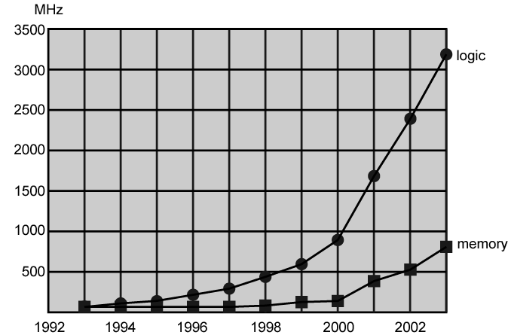
Logic and Memory Performance Gap

Slide 8
Solutions
There are number of ways that a system architect can attack this problem, as can be seen in contemporary computers. Few examples:
Increase number of bits retrieved at one time
Make RAM “wider (number of bits in a word)” rather than “deeper(number of words in RAM)”
Change RAM interface
Add Cache
Reduce frequency of memory access
More complex cache and cache on chip
Increase interconnection bandwidth
High speed buses
Hierarchy of buses

Slide 9
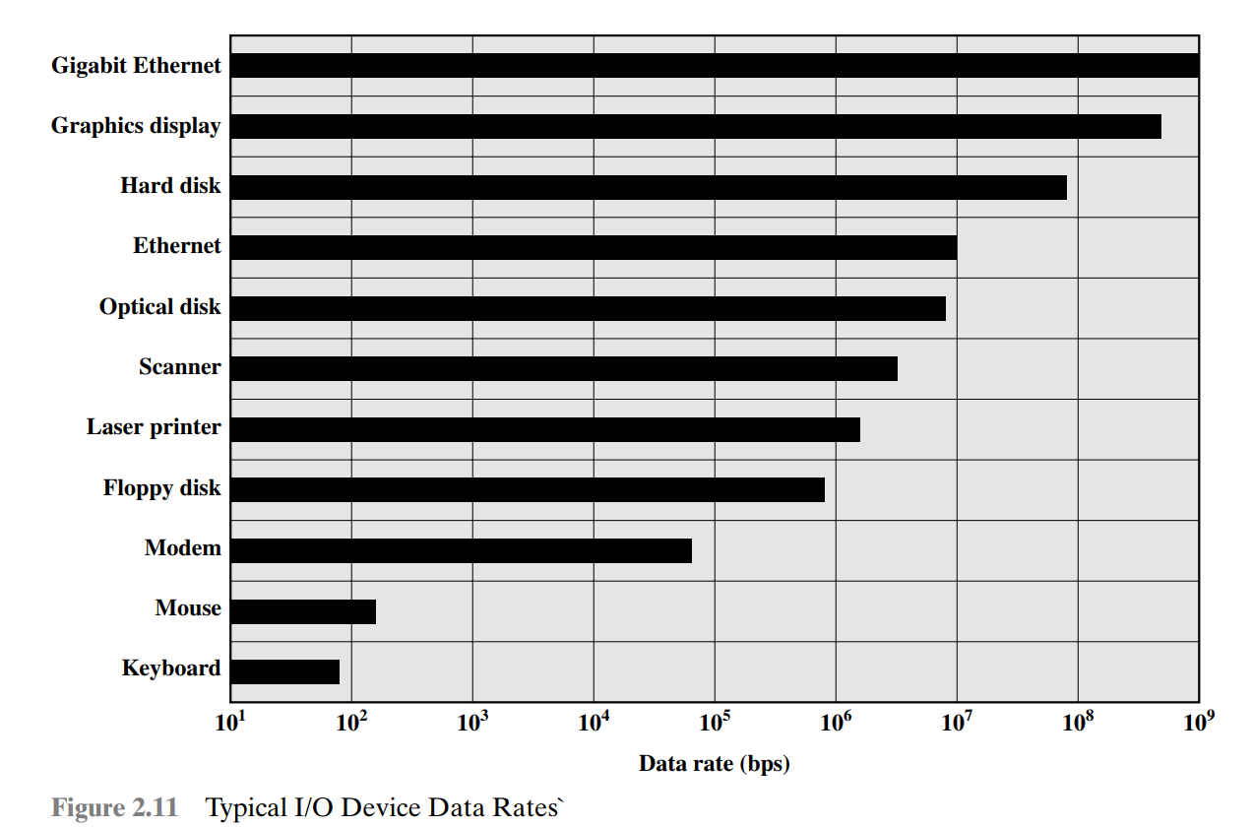
Handling I/O Devices

Slide 10
Handling of I/O Devices
Another area of design focus
Processor speed + sophisticated applications
support peripherals with intensive I/O demands
And large data throughput demands
Processors can handle this but… there remains the problem moving data between processor & peripherals
Some solutions are:
Caching
Buffering
Higher-speed interconnection buses

Slide 11
Key is Balance
Designers constantly strive to balance the throughput and processing demands between:
Processor components
Main memory
I/O devices
Interconnection structures
As designers wrestle with the challenge of balancing processor performance with that of main memory and other components, the need to increase processor’s speed remains!

Slide 12
Improvements in Chip Organization and Architecture
Three approaches to achieving increased processor speed:
Increase hardware speed of processor
Fundamentally due to shrinking logic gate size
More gates, packed more tightly, increasing clock rate
Propagation time for signals reduced
Increase size and speed of caches
Dedicating part of processor chip
Cache access times drop significantly
Change processor organization and architecture
Increase effective speed of instruction execution
Parallelism

Slide 13
Problems with Clock Speed and Logic Density
Power
Power density increases with density of logic and clock speed
Dissipating heat
RC delay
Speed at which electrons flow limited by resistance and capacitance of metal wires connecting them
Wire interconnects thinner, increasing resistance
Wires closer together, increasing capacitance
Memory latency
Memory speeds lag processor speeds
Solution:
More emphasis on organizational and architectural approaches

Slide 14
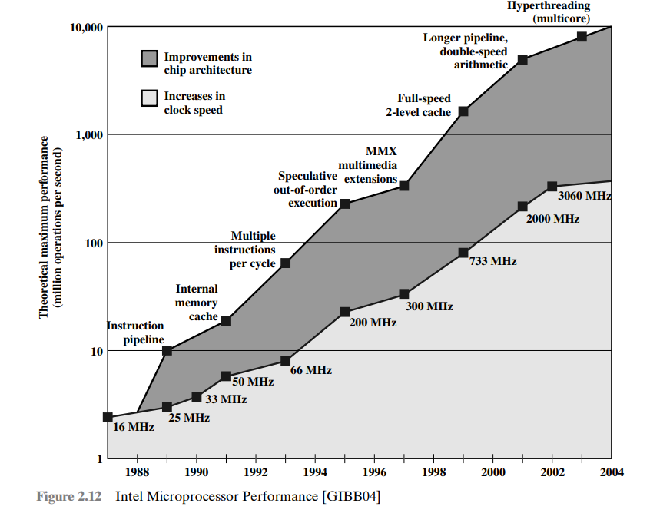

Slide 15
Two main strategies have been used
To increase the performance beyond what can be achieved simply by increasing clock speed
Increased Cache Capacity
More Complex Execution Logic

Slide 16
Increased Cache Capacity
Typically two or three levels of cache between processor and main memory
Chip density increased
More cache memory on chip
Original Pentium chip devoted about 10% of chip area to cache
Pentium 4 devotes about 50%

Slide 17
More Complex Execution Logic
Enable parallel execution of instructions
Pipeline works like assembly line
Different stages of execution of different instructions at same time along pipeline
Superscalar allows multiple pipelines within single processor
Instructions that do not depend on one another can be executed in parallel

Slide 18
More Complex Execution Logic
INPUT
Stage1
Stage2
Stage3
Fetch | Decode | Execute
Fetch | Decode | Execute

Slide 19
Diminishing Returns
Internal organization of processors complex
Can get a great deal of parallelism
Further significant increases likely to be relatively modest
Increasing clock rate runs into power dissipation problem
Some fundamental physical limits are being reached

Slide 20
New Approach – Multiple Cores
So, use two or more simpler processors on the chip rather than one more complex processor
Saved from increasing clock rate
Referred to as multicore also
With two processors, larger caches are justified
Power consumption of memory logic less than processing logic
Example: IBM POWER4
Two cores based on PowerPC

Slide 21
Notes:
Beginning in the late 1980s, and continuing for about 15 years, two main
strategies have been used to increase performance beyond what can be achieved
simply by increasing clock speed. First, there has been an increase in cache capacity.
There are now typically two or three levels of cache between the processor and
main memory. As chip density has increased, more of the cache memory has been
incorporated on the chip, enabling faster cache access. For example, the original
Pentium chip devoted about 10% of on-chip area to caches. Contemporary chips
devote over half of the chip area to caches. And, typically, about three-quarters of the
other half is for pipeline-related control and buffering.
Second, the instruction execution logic within a processor has become increasingly
complex to enable parallel execution of instructions within the processor. Two
noteworthy design approaches have been pipelining and superscalar. A pipeline
works much as an assembly line in a manufacturing plant enabling different stages
of execution of different instructions to occur at the same time along the pipeline. A
superscalar approach in essence allows multiple pipelines within a single processor
so that instructions that do not depend on one another can be executed in parallel.
By the mid to late 90s, both of these approaches were reaching a point of
diminishing returns. The internal organization of contemporary processors is
exceedingly complex and is able to squeeze a great deal of parallelism out of the
instruction stream. It seems likely that further significant increases in this direction
will be relatively modest [GIBB04]. With three levels of cache on the processor
chip, each level providing substantial capacity, it also seems that the benefits from
the cache are reaching a limit.
However, simply relying on increasing clock rate for increased performance
runs into the power dissipation problem already referred to. The faster the clock
rate, the greater the amount of power to be dissipated, and some fundamental physical
limits are being reached.
Figure 2.2 illustrates the concepts we have been discussing. The top line
shows that, as per Moore’s Law, the number of transistors on a single chip continues
to grow exponentially. Meanwhile, the clock speed has leveled off, in order
to prevent a further rise in power. To continue to increase performance, designers
have had to find ways of exploiting the growing number of transistors other than
simply building a more complex processor. The response in recent years has been
the development of the multicore computer chip.

Slide 22
Many Integrated Core (MIC) Graphics Processing Unit (GPU)
MIC(Many Integrated Core)
GPU (Graphics Processing Unit)
Leap in performance as well as the challenges in developing software to exploit such a large number of cores
The multicore and MIC strategy involves a homogeneous collection of general purpose processors on a single chip
Core designed to perform parallel operations on graphics data
Traditionally found on a plug-in graphics card, it is used to encode and render 2D and 3D graphics as well as process video
Used in variety of applications that require repetitive computations
Notes:
Chip manufacturers are now in the process of making a huge leap forward
in the number of cores per chip, with more than 50 cores per chip. The leap in
performance as well as the challenges in developing software to exploit such a large
number of cores have led to the introduction of a new term: many integrated core
(MIC).
The multicore and MIC strategy involves a homogeneous collection of
general-purpose processors on a single chip. At the same time, chip manufacturers
are pursuing another design option: a chip with multiple general-purpose processors
plus graphics processing units (GPUs) and specialized cores for video processing
and other tasks. In broad terms, a GPU is a core designed to perform parallel
operations on graphics data. Traditionally found on a plug-in graphics card (display
adapter), it is used to encode and render 2D and 3D graphics as well as process
video.
Since GPUs perform parallel operations on multiple sets of data, they are
increasingly being used as vector processors for a variety of applications that
require repetitive computations. This blurs the line between the GPU and the
CPU [FATA08, PROP11]. When a broad range of applications are supported
by such a processor, the term general-purpose computing on GPUs (GPGPU)
is used.
We explore design characteristics of multicore computers in Chapter 18 and
GPGPUs in Chapter 19.

Slide 23
Summary
Advances in software require much more processing speed
Contemporary techniques exist, but there is a need to keep balance
Increase processor speed by increasing clock cycle have consequences, we deal with them through two techniques
Logic Density has obvious consequences, so use the concept of Multicore

Slide 24
x86 Architecture
ARM
Overview
Advanced RISC Machine Ltd
Intel
Results of decades of design effort on complex instruction set computers (CISCs)
Excellent example of CISC design
Incorporates the sophisticated design principles once found only on mainframes and supercomputers
An alternative approach to processor design is the reduced instruction set computer (RISC)
The ARM architecture is used in a wide variety of embedded systems and is one of the most powerful and best designed RISC based systems on the market
In terms of market share Intel is ranked as the number one maker of microprocessors for non-embedded systems
Integrated Electronics
CISC
RISC
Notes:
Throughout this book, we rely on many concrete examples of computer design
and implementation to illustrate concepts and to illuminate trade-offs. Numerous
systems, both contemporary and historical, provide examples of important computer
architecture design features. But the book relies on examples from two processor
families: the Intel x86 and the ARM architecture. The current x86 offerings represent
the results of decades of design effort on complex instruction set computers
(CISCs). The x86 incorporates the sophisticated design principles once found only on
mainframes and supercomputers and serves as an excellent example of CISC design.
An alternative approach to processor design in the reduced instruction set computer
(RISC). The ARM architecture is used in a wide variety of embedded systems and
is one of the most powerful and best-designed RISC-based systems on the market.
In this section and the next, we provide a brief overview of these two systems.
In terms of market share, Intel has ranked as the number one maker of microprocessors
for non-embedded systems for decades, a position it seems unlikely to
yield. The evolution of its flagship microprocessor product serves as a good indicator
of the evolution of computer technology in general.
Table 2.6 shows that evolution. Interestingly, as microprocessors have grown
faster and much more complex, Intel has actually picked up the pace. Intel used
to develop microprocessors one after another, every four years. But Intel hopes
to keep rivals at bay by trimming a year or two off this development time, and has
done so with the most recent x86 generations.

Slide 25
Introduction
We follow ARM, and x86 processor architecture
X86:
Relies on CISC(Complex Instruction Set Computers)
decades of hard work
ARM:
Relies on RISC(Reduced Instruction set Architecture)
We will provide a brief overview of these systems
Intel is a leading manufacturer in specially non-embedded systems

Slide 26
Evolution of Intel Microprocessor
8080:
World’s first general purpose microprocessor
8 bit machine
8086:
16 bit machine
First appearance of x86 architecture
Used in a IBM Pc

Slide 27
Evolution of Intel Microprocessor
80386:
32 Bit machine
First to use the concept of MultiTasking
80486:
Powerful cache tecnhnology

Slide 28
Evolution of Intel Microprocessor
Pentium:
Introduction of super scalar technology
Pentium-II:
MMX Technology
Process Video, Audio and Graphics Data

Slide 29
Evolution of Intel Microprocessor
Pentium-III:
Additional Instruction
Process 3d Graphics Software
Pentium-IV:
Enhancement for Multimedia

Slide 30
Evolution of Intel Microprocessor
Core:
First x86 processor with dual core
Two processors on a single chip
Core 2:
Extension of Architecture
64 Bits

Slide 31
ARM Architecture
Evolved from RISC design principles
Used in Embedded System

Slide 32

General definition:
“A combination of computer
hardware and software, and perhaps additional mechanical or other parts, designed to perform a dedicated function. In many cases, embedded systems are part of a larger system or product, as in the case of an antilock braking system in a car.”
Embedded
Systems
Notes:
The term embedded system refers to the use of electronics and software within a
product, as opposed to a general-purpose computer, such as a laptop or desktop
system. The following is a good general definition:
Embedded system. A combination of computer hardware and software, and perhaps
additional mechanical or other parts, designed to perform a dedicated function. In many
cases, embedded systems are part of a larger system or product, as in the case of an antilock
braking system in a car.

Slide 33
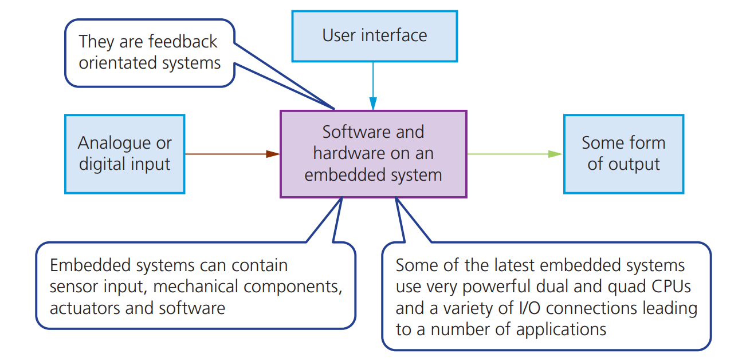
Embedded Systems

Slide 34
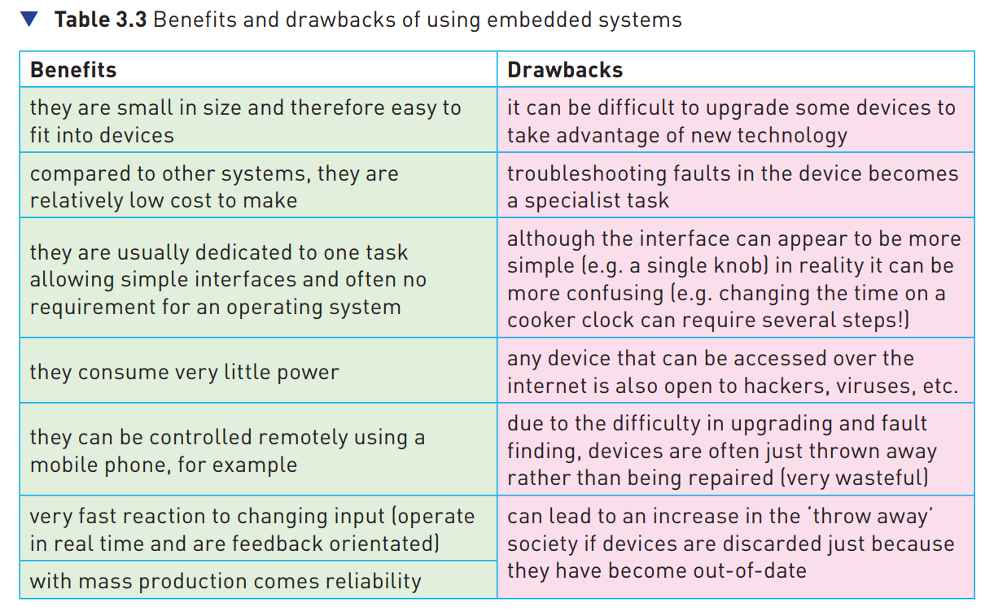
Benefits and Drawbacks

Slide 35
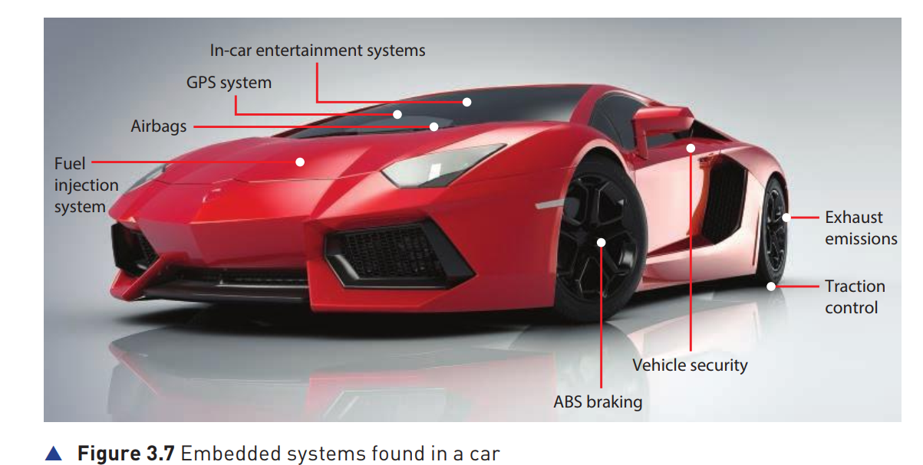
Embedded System

Slide 36
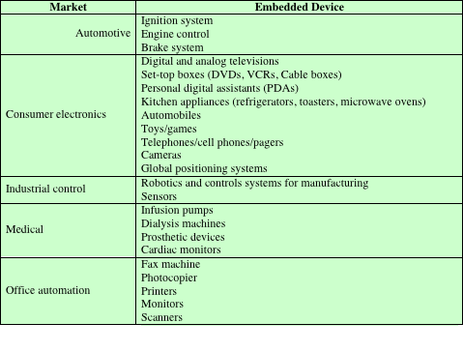
Table 2.7 Examples of Embedded Systems and Their Markets
Notes:
Embedded systems far outnumber general-purpose computer systems, encompassing
a broad range of applications (Table 2.7).

Slide 37
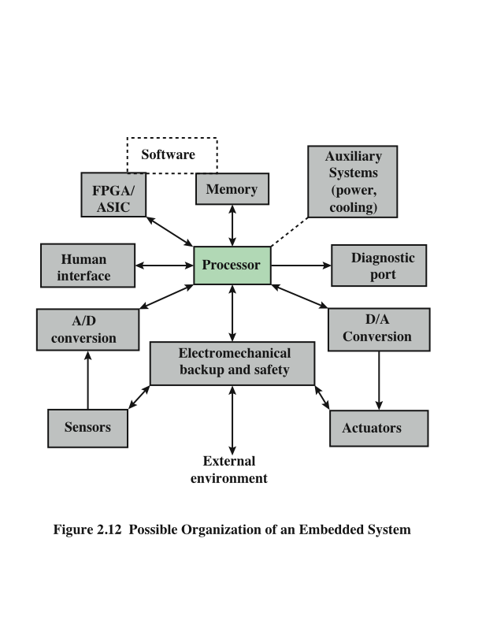
Figure 2.12 Possible Organization of an Embedded System
Field-Programmable Gate Array/Application-Specific Integrated Circuit
Notes:
Figure 2.12, based on [KOOP96], shows in general terms an embedded system
organization. In addition to the processor and memory, there are a number of
elements that differ from the typical desktop or laptop computer:
• There may be a variety of interfaces that enable the system to measure,
Manipulate, and otherwise interact with the external environment.
• The human interface may be as simple as a flashing light or as complicated as
real-time robotic vision.
The diagnostic port may be used for diagnosing the system that is being
controlled—not just for diagnosing the computer.
• Special-purpose field programmable (FPGA), application specific (ASIC), or
even non-digital hardware may be used to increase performance or safety.
• Software often has a fixed function and is specific to the application.

Slide 38
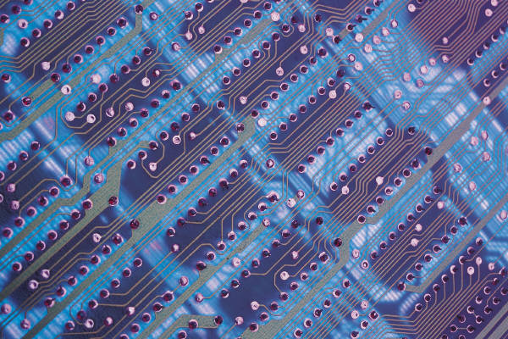
Acorn RISC Machine (ARM)
Family of RISC-based microprocessors and microcontrollers
Designs microprocessor and multicore architectures and licenses them to manufacturers
Chips are high-speed processors that are known for their small die size and low power requirements
Widely used in PDAs and other handheld devices
Chips are the processors in iPod and iPhone devices
Most widely used embedded processor architecture
Most widely used processor architecture of any kind
Notes:
ARM is a family of RISC-based microprocessors and microcontrollers designed
by ARM Inc., Cambridge, England. The company doesn’t make processors but
instead designs microprocessor and multicore architectures and licenses them to
manufacturers. ARM chips are high-speed processors that are known for their
small die size and low power requirements. They are widely used in PDAs and
other handheld devices, including games and phones as well as a large variety
of consumer products. ARM chips are the processors in Apple’s popular iPod
and iPhone devices. ARM is probably the most widely used embedded processor
architecture and indeed the most widely used processor architecture of any kind
in the world.
The origins of ARM technology can be traced back to the British-based Acorn
Computers company. In the early 1980s, Acorn was awarded a contract by the
British Broadcasting Corporation (BBC) to develop a new microcomputer architecture
for the BBC Computer Literacy Project. The success of this contract enabled
Acorn to go on to develop the first commercial RISC processor, the Acorn RISC
Machine (ARM). The first version, ARM1, became operational in 1985 and was
used for internal research and development as well as being used as a coprocessor
in the BBC machine. Also in 1985, Acorn released the ARM2, which had greater
functionality and speed within the same physical space. Further improvements were
achieved with the release in 1989 of the ARM3.

Slide 39
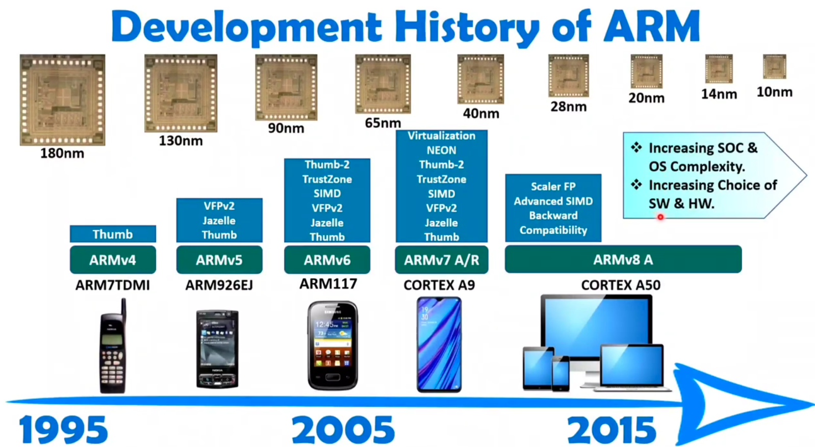

Slide 40
ARM Design Categories
ARM processors are designed to meet the needs of three system categories:
Secure applications
Smart cards, SIM cards, and payment terminals
Application platforms
Devices running open operating systems including Linux, Palm OS, Symbian OS, and Windows CE (Windows Embedded Compact) in wireless, consumer entertainment and digital imaging applications
Embedded real-time systems
Systems for storage, automotive body and power-train, industrial, and networking applications
Notes:
According to the ARM Web site arm.com, ARM processors are designed to
meet the needs of three system categories:
• Embedded real-time systems: Systems for storage, automotive body and
power-train, industrial, and networking applications
• Application platforms: Devices running open operating systems including
Linux, Palm OS, Symbian OS, and Windows CE in wireless, consumer entertainment
and digital imaging applications
• Secure applications: Smart cards, SIM cards, and payment terminals

Slide 41
CISC VS RISC
Complex Instruction set Architecture | Reduced Instruction set Architecture
Large Number of Instructions | Fewer Number of Instructions
Variable length Instruction format | Fixed Length Instruction format
Cost is High | Lesser Cost
More Powerful | Less powerful
Manipulation directly in memory | Only in Registers
Several Cycle Instruction | Single Cycle Instruction
Microprogrammed control unit | Hardwired control unit

Slide 42
Performance
Performance is a key characteristic, when evaluating hardware and setting requirements for a new system
Performance not only depends on the speed but:
Instruction set
Choice of implementation of language
Efficiency of compiler
Skill of programming done

Slide 43
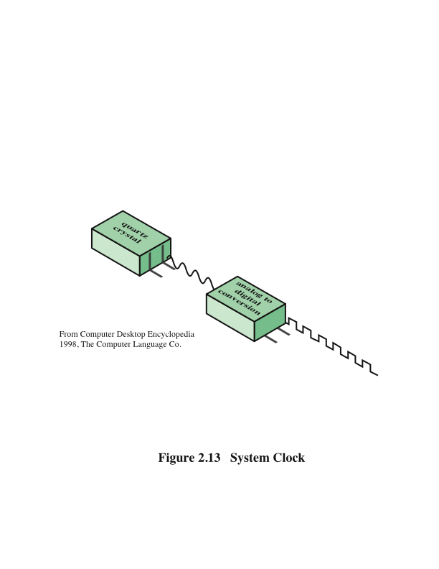
System Clock
Notes:
Operations performed by a processor, such as fetching an
instruction, decoding the instruction, performing an arithmetic operation, and so
on, are governed by a system clock. Typically, all operations begin with the pulse of
the clock. Thus, at the most fundamental level, the speed of a processor is dictated
by the pulse frequency produced by the clock, measured in cycles per second, or
Hertz (Hz).
Typically, clock signals are generated by a quartz crystal, which generates a
constant signal wave while power is applied. This wave is converted into a digital
voltage pulse stream that is provided in a constant flow to the processor circuitry
(Figure 2.13). For example, a 1-GHz processor receives 1 billion pulses per second.
The rate of pulses is known as the clock rate, or clock speed. One increment, or
pulse, of the clock is referred to as a clock cycle, or a clock tick. The time between
pulses is the cycle time.
The clock rate is not arbitrary, but must be appropriate for the physical layout
of the processor. Actions in the processor require signals to be sent from one processor
element to another. When a signal is placed on a line inside the processor, it
takes some finite amount of time for the voltage levels to settle down so that an
accurate value (1 or 0) is available. Furthermore, depending on the physical layout
of the processor circuits, some signals may change more rapidly than others. Thus,
operations must be synchronized and paced so that the proper electrical signal
(voltage) values are available for each operation.
The execution of an instruction involves a number of discrete steps, such
as fetching the instruction from memory, decoding the various portions of the
instruction, loading and storing data, and performing arithmetic and logical operations.
Thus, most instructions on most processors require multiple clock cycles to
complete. Some instructions may take only a few cycles, while others require dozens.
In addition, when pipelining is used, multiple instructions are being executed simultaneously.
Thus, a straight comparison of clock speeds on different processors does
not tell the whole story about performance.

Slide 44
System Clock
Operations done by the microprocessor
Governed by a system clock
Clock signals are generated:
By a quartz crystal
Generates a constant wave of pulses
Converted into digital: constant flow to processor
One increment or One pulse: Clock Cycle or tick
The rate of pulses is number of clock cycles per second
1 GHZ processor receives 1 billion instructions per second

Slide 45
Amdahl's Law (Speed-up Performance Law)
It is one of the speedup performance law
Potential speedup of an algorithm on parallel computing platforms is given by Amdahl’s Law
It is a law which governs:
Speed up of using parallel processor on a problem vs using serial processor on a problem under the assumption that problem size remains the same
Speed-up:
Ratio of time to execute a process in serial (with one processor) to the time it takes to execute the same in parallel (with many processors)

Slide 46
Amdahl's Law (Speed-up Performance Law)
It is based on fixed problem size
It states:
Speed doesn’t increase linearly as the number of processors increase, but it tends to become saturated at some point

Slide 47
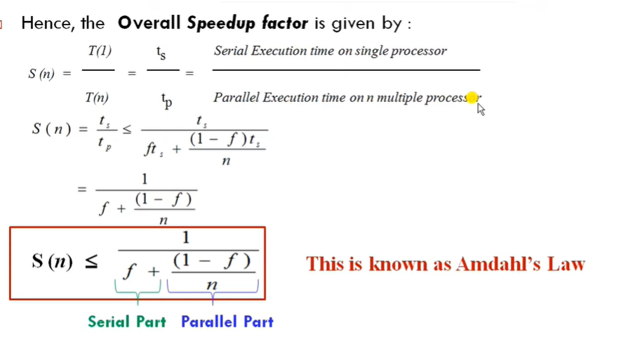

Slide 48
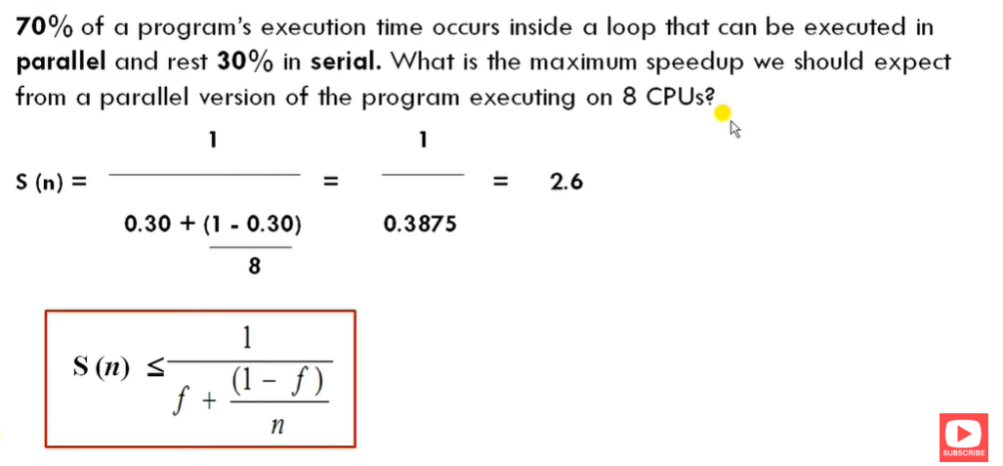
Problem

Slide 49
Solution

Slide 50
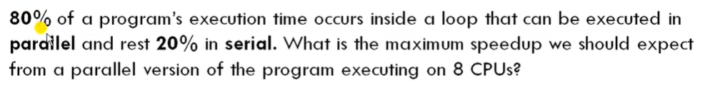
Problem

Slide 51
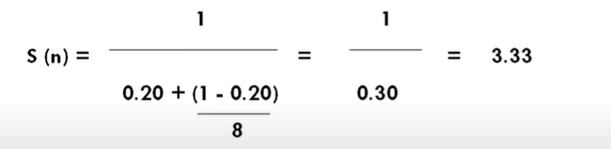
Solution

Slide 52
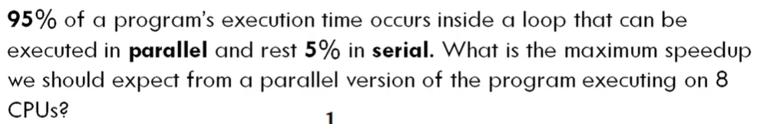
Problem

Slide 53

Solution

Slide 54
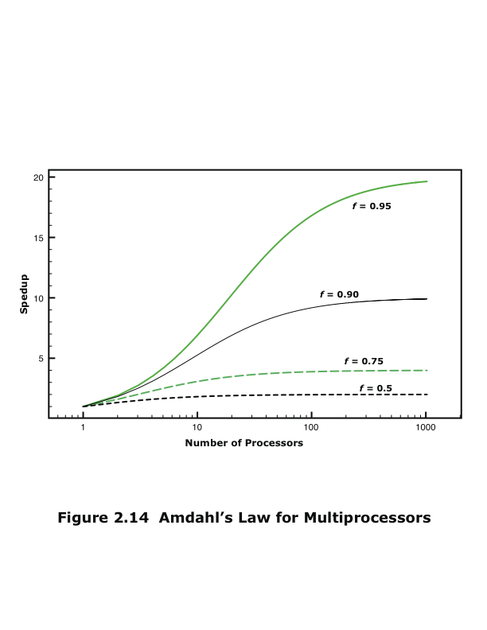
Amdahl’s Law
The speed-up of a program from parallelization is limited by how much of the program can be parallelized. For example, if 95% of the program can be parallelized, the theoretical maximum speedup using parallel computing would be 20× as shown in the diagram, no matter how many processors are used. If 90% of the program can be parallelized, the theoretical maximum speed-up using parallel computing would be 10×
Notes:
Consider a program running on a single processor such that a fraction
(1 – f) of the execution time involves code that is inherently serial and a fraction
f that involves code that is infinitely parallelizable with no scheduling overhead.
Let T be the total execution time of the program using a single processor. Then the
speedup using a parallel processor with N processors that fully exploits the parallel
portion of the program is as follows:
Speedup =
Time to execute program on a single processor
Time to execute program on N parallel processors
=T(1 - f) + Tf
T(1 - f) +Tf
N
= 1
(1 - f) +f
N
This equation is illustrated in Figure 2.14. Two important conclusions can be
drawn:
1. When f is small, the use of parallel processors has little effect.
2. As N approaches infinity, speedup is bound by 1/(1 – f), so that there are
diminishing returns for using more processors.
These conclusions are too pessimistic, an assertion first put forward in
[GUST88]. For example, a server can maintain multiple threads or multiple tasks
to handle multiple clients and execute the threads or tasks in parallel up to the limit
of the number of processors. Many database applications involve computations on
massive amounts of data that can be split up into multiple parallel tasks.

